Slide 1



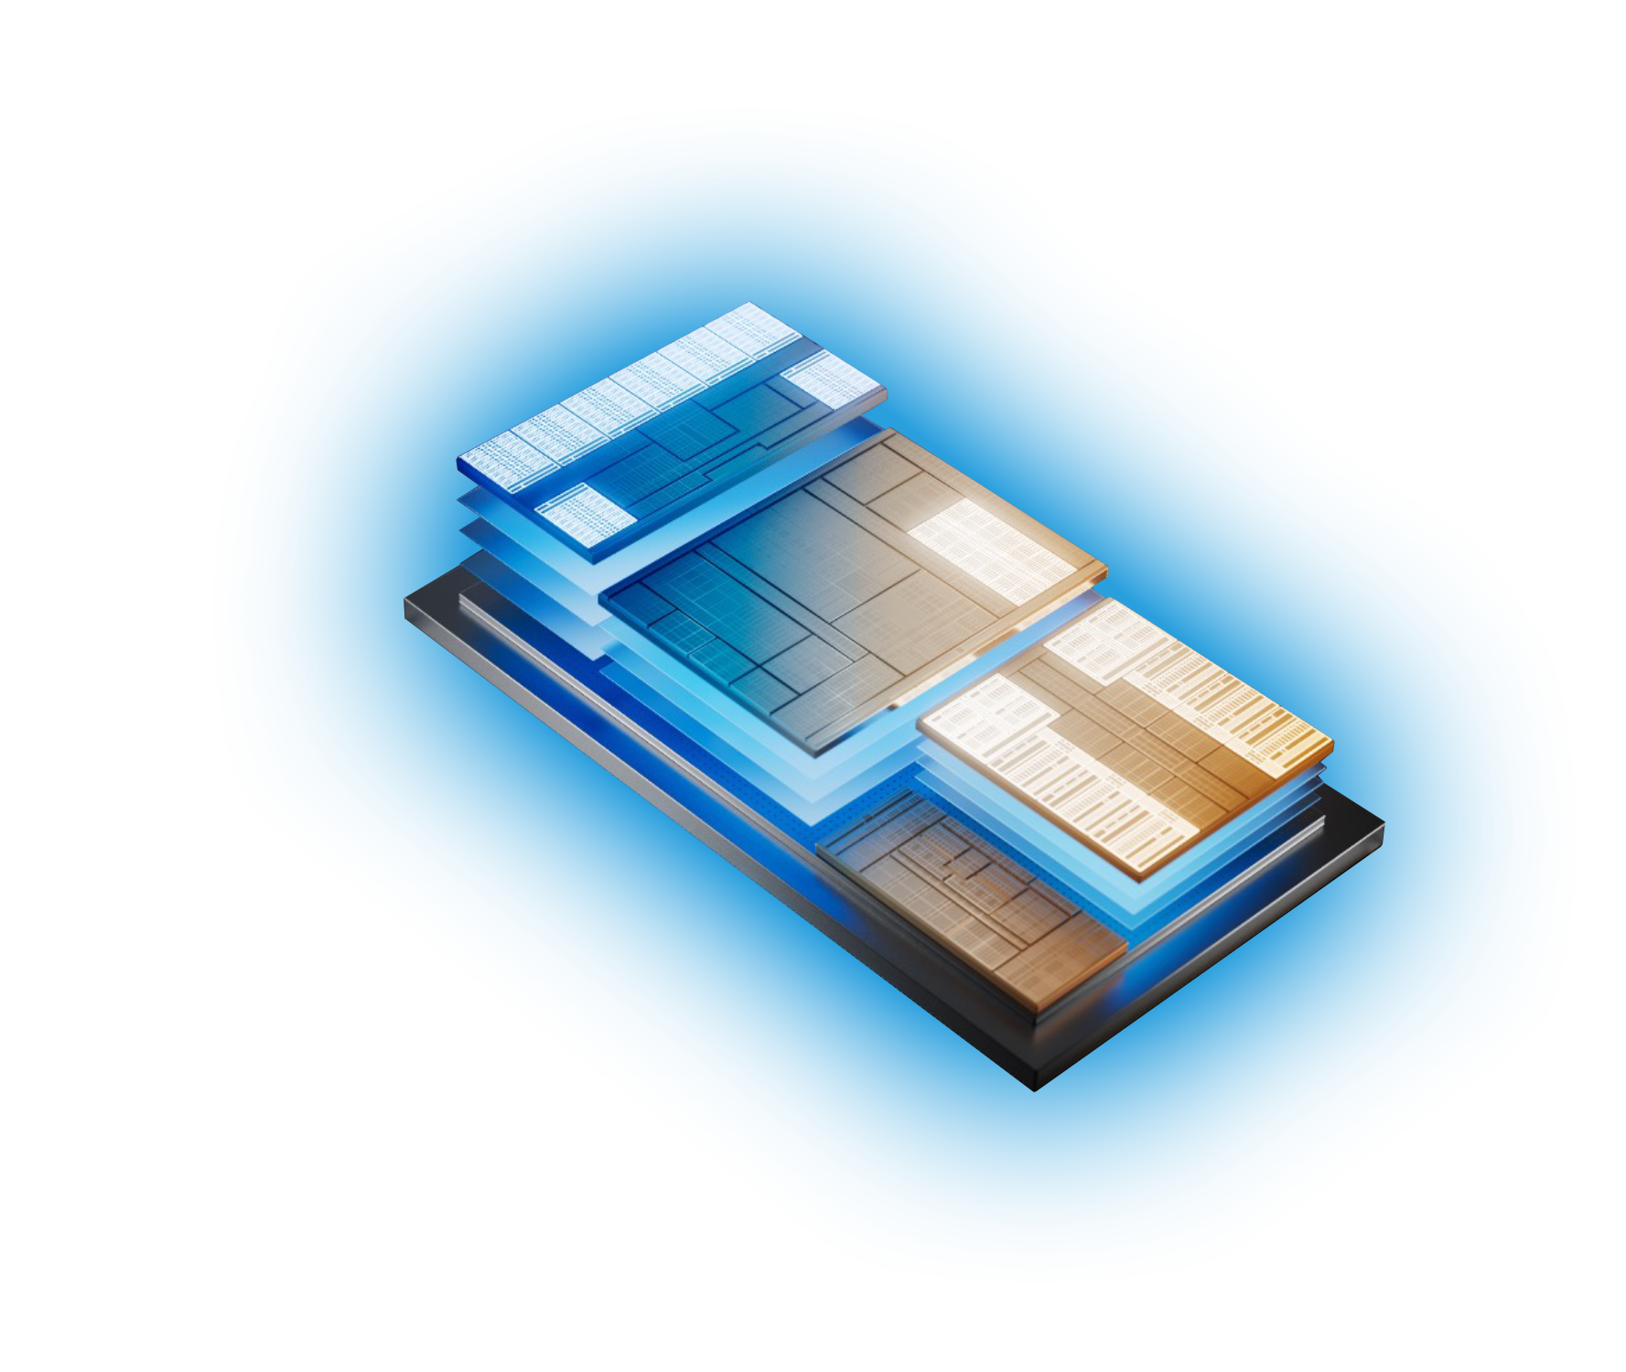
Empower your customers to embrace AI
Remember all those devices you sold during the pandemic? They’re now ready for a refresh. Intel and Microsoft have partnered on a go-to-market campaign to help you upgrade your customers’ device fleets with AI-driven Windows 11
Pro PCs powered by Intel® Core™ Ultra processors.
$500+ B
75%
64%
is the projected worldwide
spending on AI solutions in 2027.¹
of global knowledge workers
are using AI.²
of businesses expect AI to
increase productivity.³
What is an AI-driven PC?
AI runs best on Intel⁴
A PC with an Intel® Core™ Ultra processor that brings new AI experiences in productivity, creativity, and security through the combined power of the CPU, GPU, and the new NPU.
Great AI-driven PC experiences require excellence and reliability at every layer across applications, AI models, runtimes, frameworks, drivers, operating systems, and hardware.
GPU
High throughput
Wider
AI framework support
Broader
AI runtime support
100+
ISV partners
300+
NPU
Low power
AI-accelerated applications
CPU
Fast response
500+
AI models supported

Slide 2
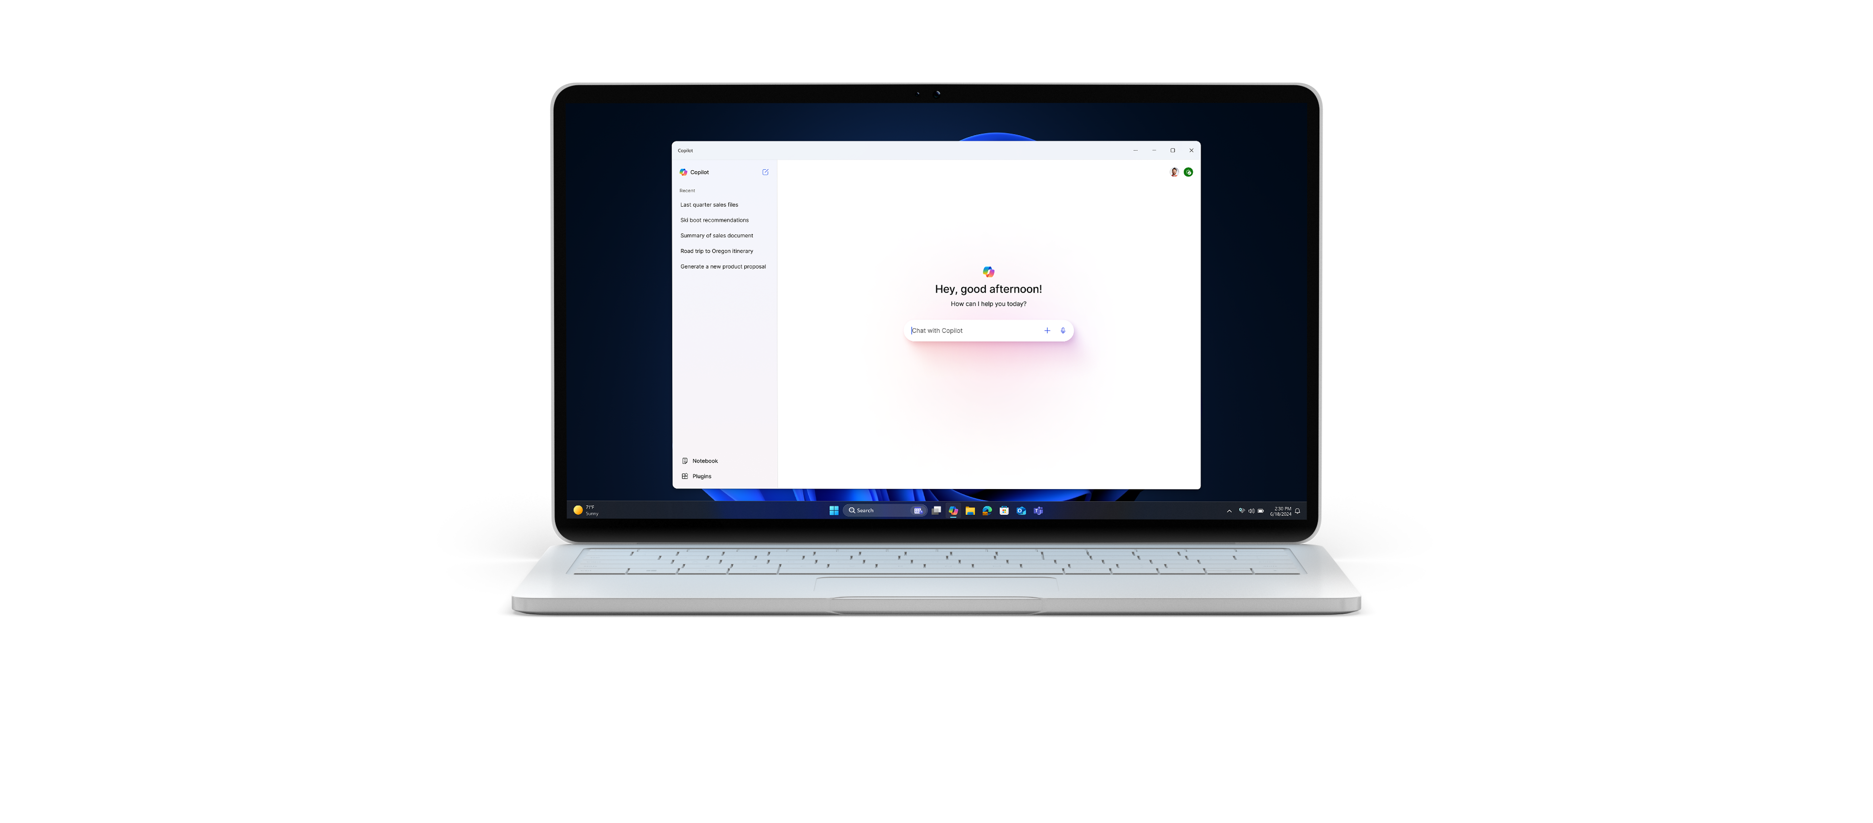

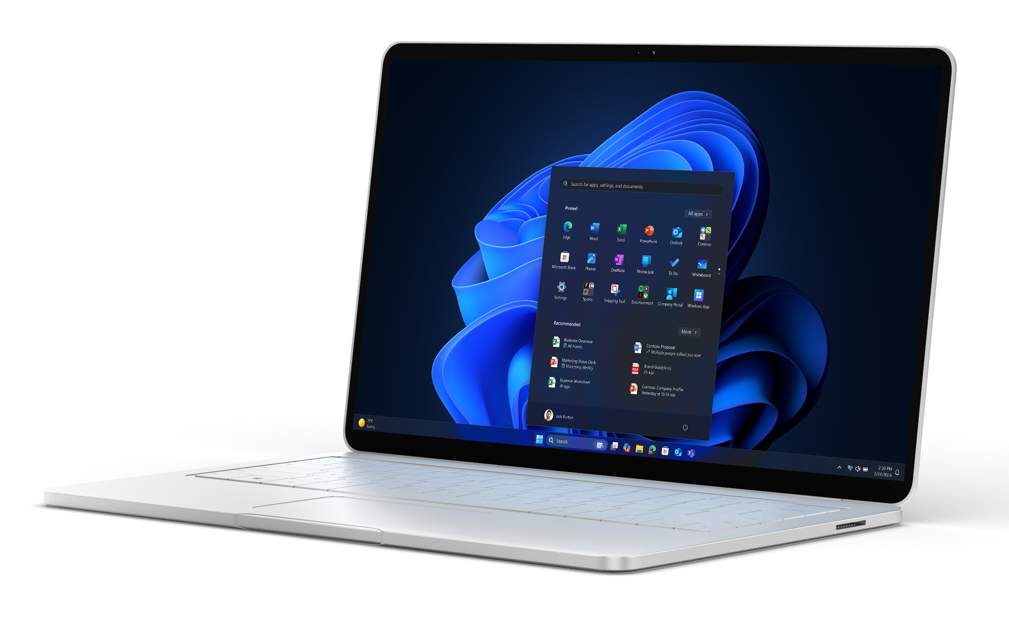
Intel and Microsoft—better together
The Intel and Microsoft Better Together campaign is designed to educate business customers on the value of AI-driven Windows 11 Pro PCs powered by Intel® Core™ Ultra processors.
Breakthrough productivity
Up to 47% better office app productivity vs 3-year-old PC⁵
Turnkey security for business
70% attack surface reduction with Intel® vPro® Hardware Shield (Secured-core PC)⁶
Easy to manage and
more cost-efficient than
you may think
25% faster deployments reported⁷
Built-in AI
applications, including
Copilot in Windows⁸
100+ ISVs and 300+ AI workloads enabled by Intel’s AI PC Acceleration Program
Helping you retire your quota faster
Email templates
Customer pitch deck
In addition to marketing assets, the campaign includes practical sales tools to help you spark and navigate customer discussions about AI-driven PCs.
Telesales script
Keynote event deck
One-pager
Competitive sales card
Ready to get started?
Download the sales tools and start reaching out to your customers. With Windows 10 end
of support coming on October 14th, 2025⁹, now’s the time to start planning your customers’ next device refresh to ensure their fleets are secure, supported, and up-to-date.
Have a question?
Don’t hesitate to contact: [Email]
¹IDC, IDC FutureScape: Artificial Intelligence Will Reshape the IT Industry and the Way Businesses Operate, 2023.
²Microsoft, Work Trend Index Annual Report, 2023.
³Forbes, 24 Top AI Statistics and Trend in 2024, 2024.
⁴Refers to laptop applications on Intel® Core™ Ultra processors, based on the broad compatibility, extensive software options, unique architecture, and impressive performance that combine to deliver the best overall AI experience compared to competition processors (as of December 2023). AI features may require additional purchases or specific compatibility requirements. See intel.com/Performance Index for details. Results may vary.
⁵Intel® Core™ Ultra 7 165H vs. 11th Gen Intel® Core™ i7-1185G7.
⁶Based on IOActive’s “Intel vPro 13th Gen Attack Surface Study” published March 2023 (commissioned by Intel), which evaluates Intel vPro devices powered by 13th Gen Intel Core processors against
four-year-old Intel-based PCs. Additional details at www.intel.com/performance-vpro.
⁷Commissioned study delivered by Forrester Consulting “The Total Economic Impact™ of Windows 11 Pro Devices”, December 2022. Note, quantified benefits reflect results over three years combined into a single composite organization that generates $1 billion in annual revenue, has 2,000 employees, refreshes hardware on a four-year cycle, and migrates the entirety of its workforce to Windows 11 devices.
⁸Copilot in Windows (in preview) is available in select global markets and will be rolled out to additional markets over time. Learn more. Copilot with commercial data protection is available at no additional cost for users with an Entra ID with an enabled, eligible Microsoft 365 license.
⁹Microsoft, Windows 10 EOS with Windows 11, Windows 365, and ESU, 2023.

